Slide 1
Statistics for journalists
#NICAR20

Slide 2


Slide 3
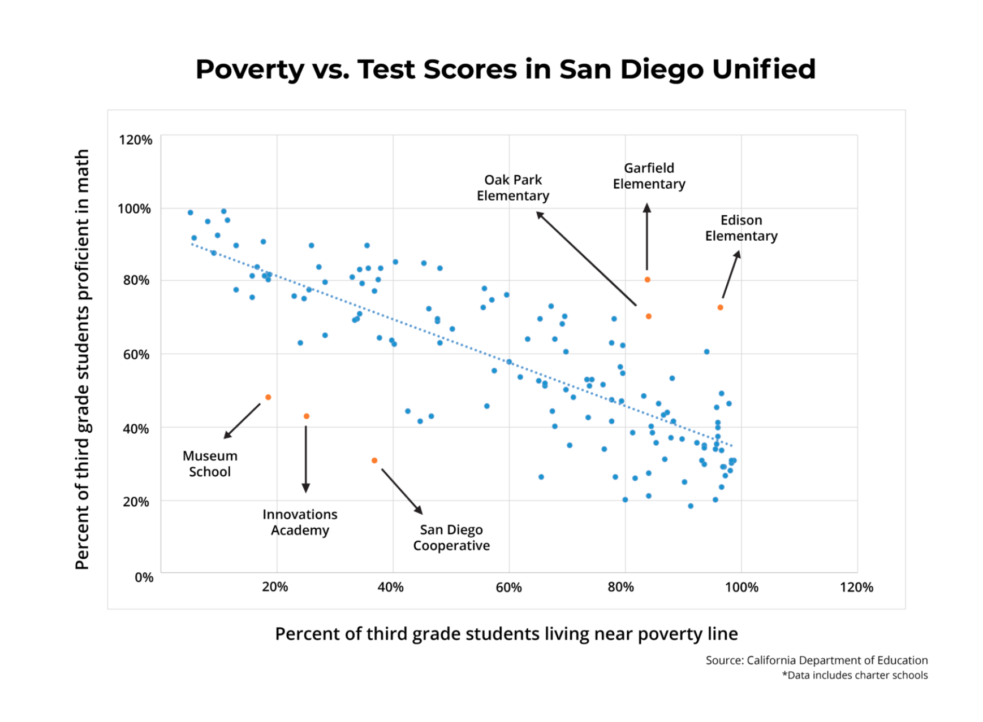

Slide 4
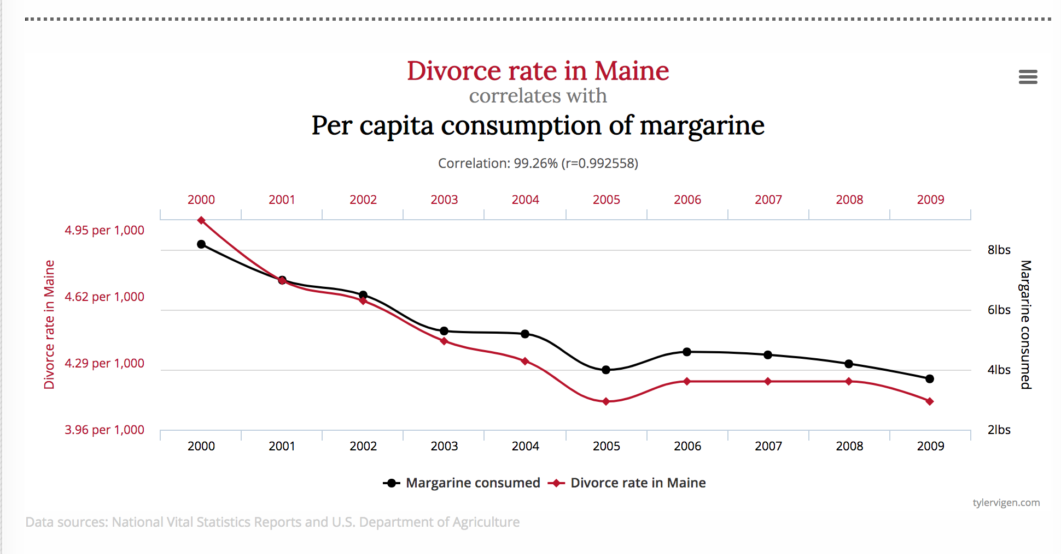

Slide 5
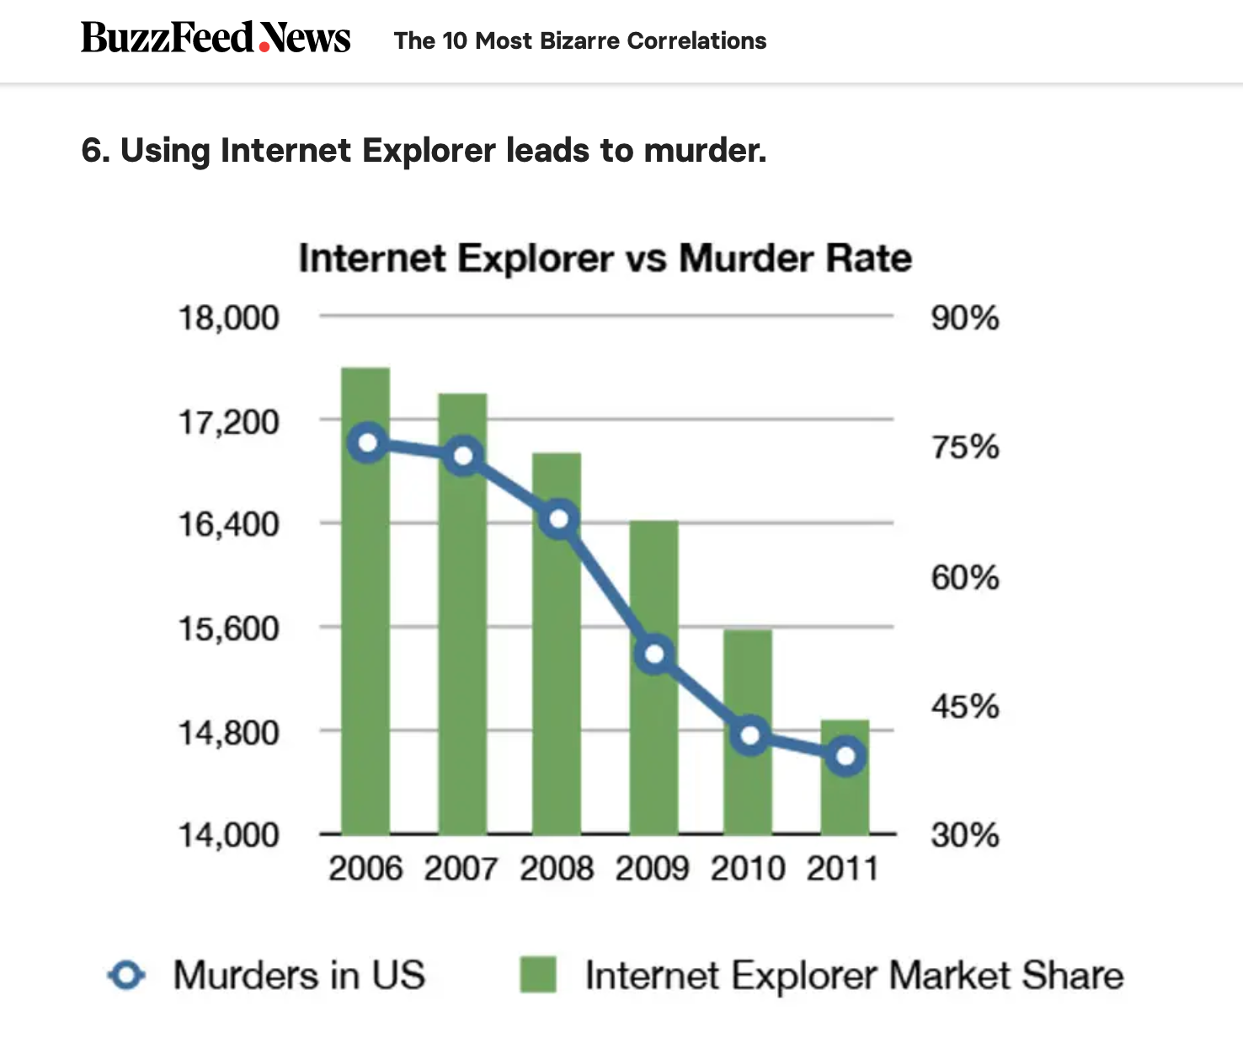

Slide 6


Slide 7


Slide 8


Slide 9
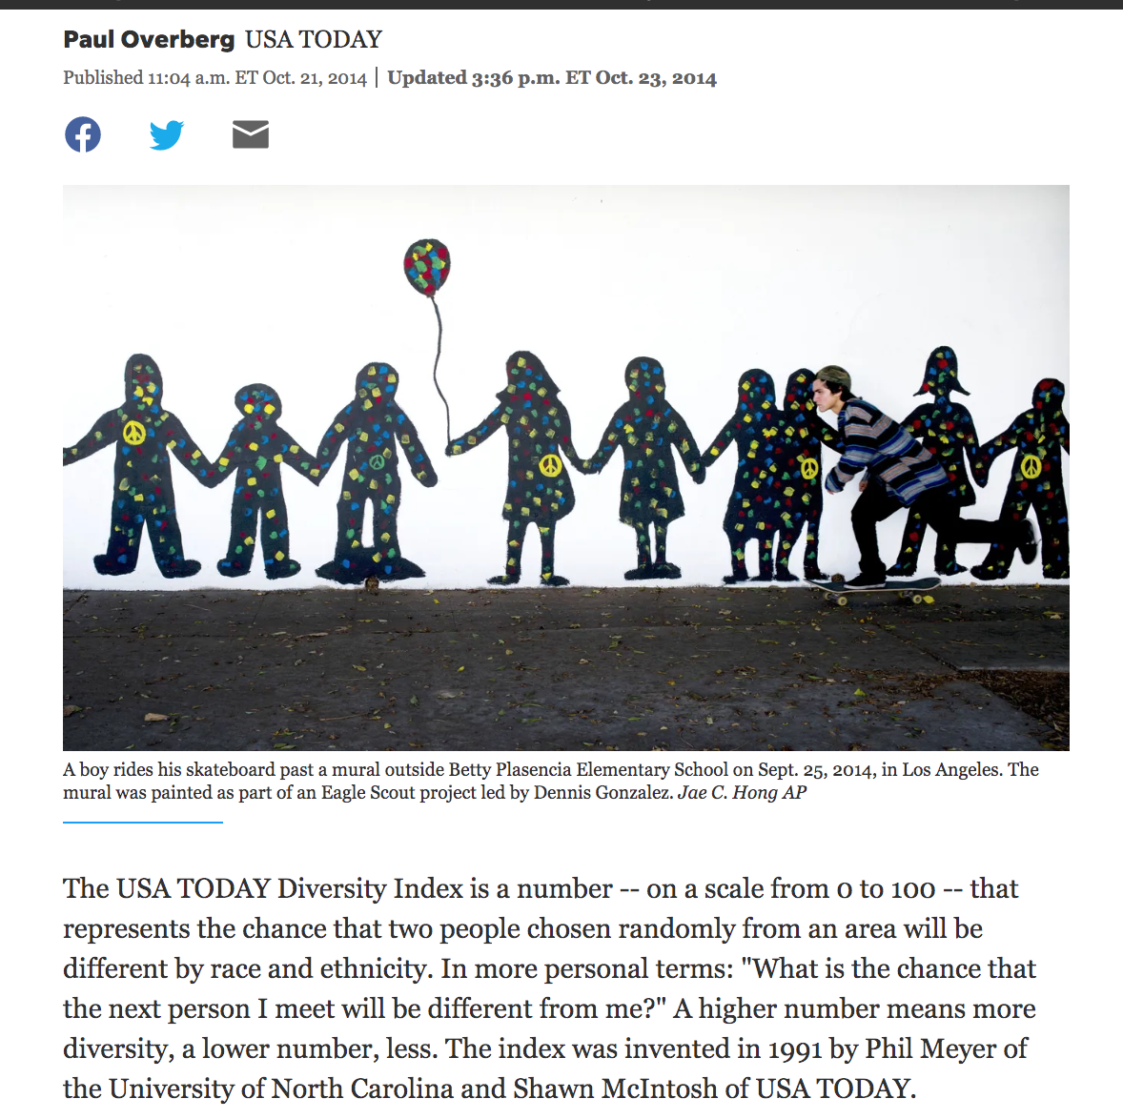

Slide 10


Slide 11
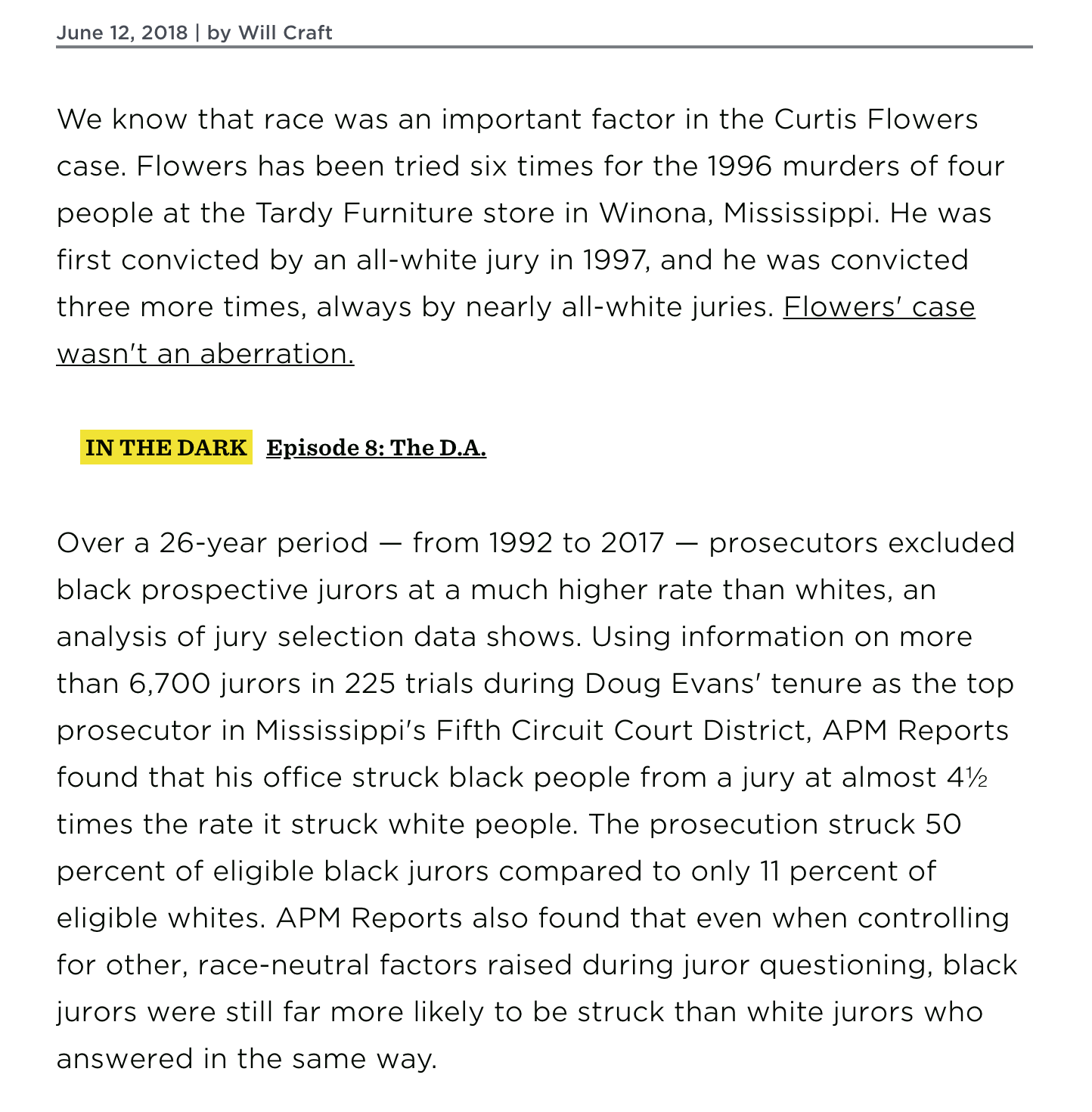

Slide 12
Getting started in R
Set working directory:
In R script:
setwd(“your path here”)
Using drop down menu:
Session -> Set Working Directory -> Choose Directory

Slide 13
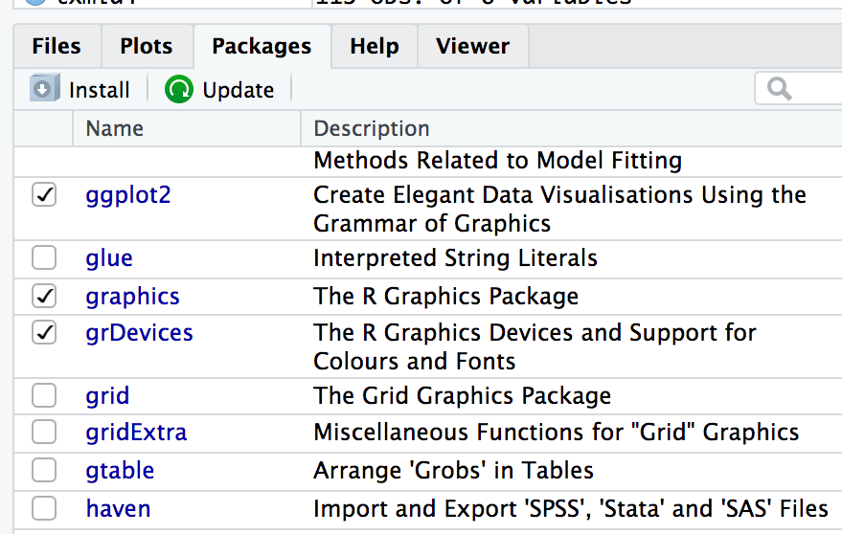
Getting started in R
Make sure these packages are installed:
dplyr
tidyverse
ggplot2
psych
Example:
install.packages(“psych”)
library(psych)

Slide 14
Load your files in R
nba <- read_csv('nba.csv', col_names = TRUE)
schools <- read_csv('txmiddle.csv', col_names = TRUE)

Slide 15
Basic descriptives
describe(nba)
Works only on numeric fields

Slide 16
Basic descriptives
Get the average for one variable:
mean(nba$height)
Get the standard deviation for one variable:
sd(nba$height)
statistic(filename$fieldname)

Slide 17
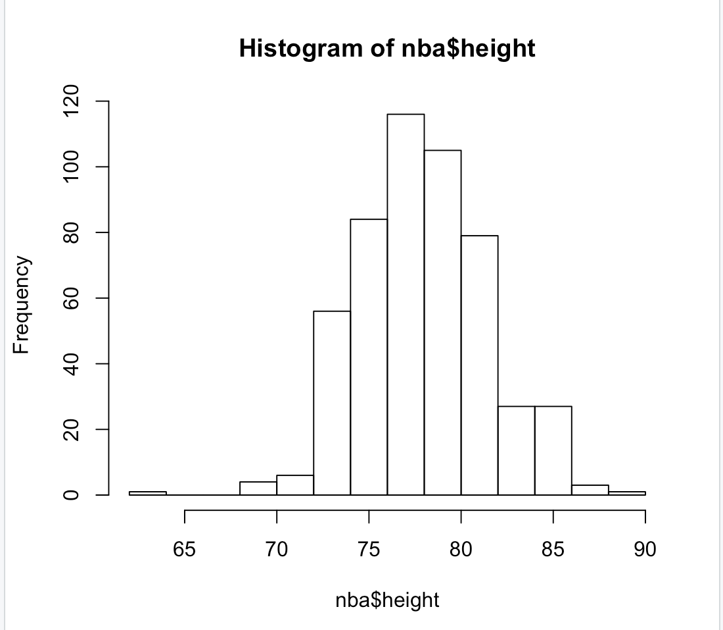
Draw pictures of your data
Histogram - shows one variable
hist(nba$height)

Slide 18
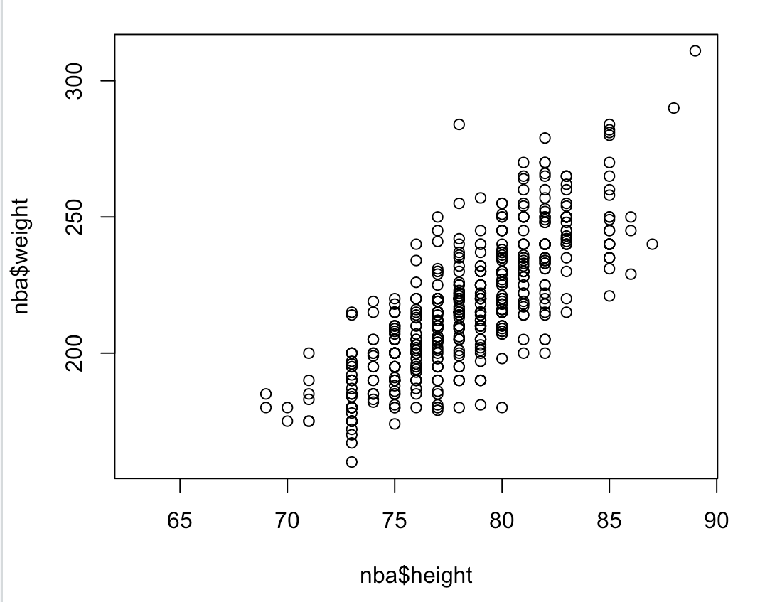
Draw pictures of your data
Scatterplot - shows two variables
plot(nba$height, nba$weight)

Slide 19
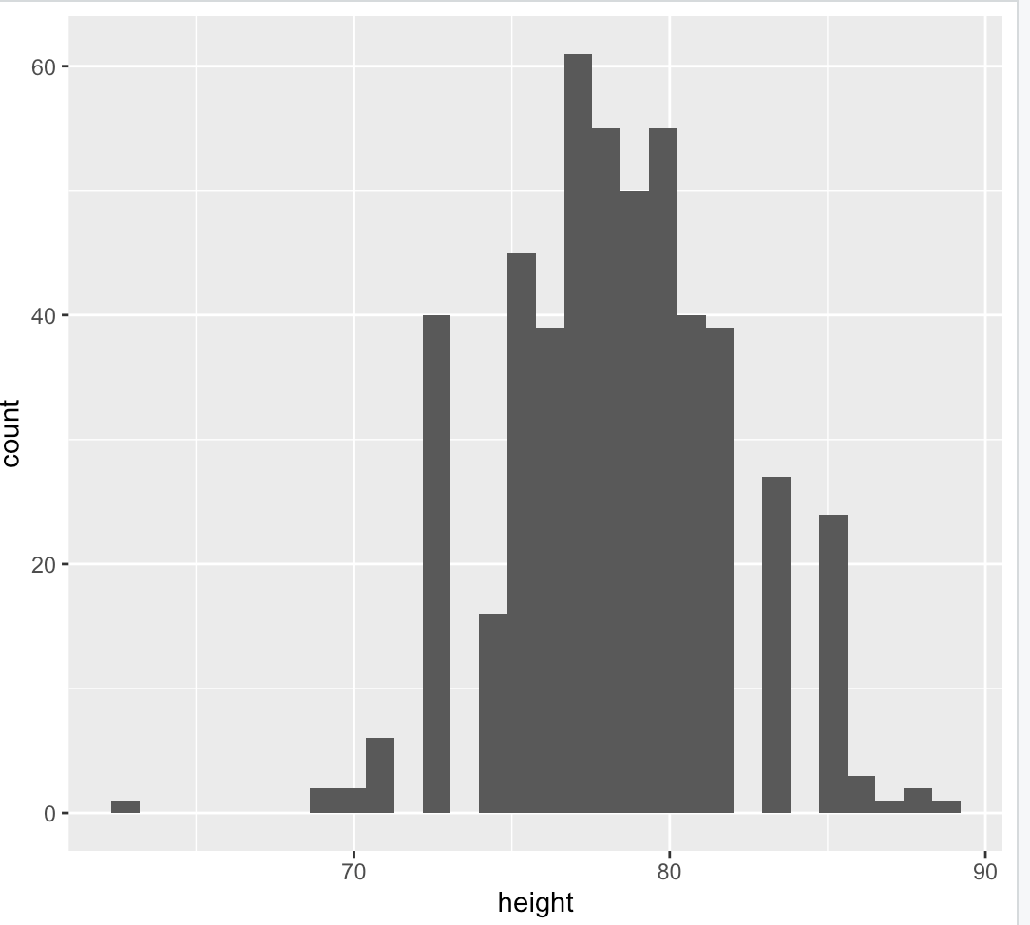
Getting fancy with ggplot2
ggplot(nba, aes(x=height)) + geom_histogram()

